Slide 1
Recovery and Management Options for Spring/Summer Chinook Salmon in the Columbia River Basin
Kareiva, P., M. Marvier and M. McClure. 2002.
Science 290: 977-979

Slide 2
To breach or not to breach, that is the question.
Some say that this paper was a hand-grenade tossed into the heated debate over whether to breach the 4 dams on the lower Snake River.

Slide 3
Opponents of breaching
“We are on a course change in the region,” said Bruce Lovelin, executive director of the Columbia River Alliance, an industry group. “Two or three years ago, dam braching seemed to be the solution. Now based on this report, it seems the problem is more in the estuary and the ocean.” –Nov. 3, 2000 Oregonian.

Slide 4
Proponents of breaching
“Conservationists and scientists who work for Northwest tribes and the Oregon and Idaho fish and wildlife departments have said that the four dams must be breached to save Snake River salmon from extinction.
On Thursday, they said the biologists’ arguments in Science do not change their opinion.” - Nov. 3, 2000 Oregonian.

Slide 5
What does this paper really say?
Outline –
Begin by reviewing basis for their analysis: age-structured matrix models of populations
Examine how they estimated the parameters
Look at implications of findings
Please raise questions at any time.

Slide 6
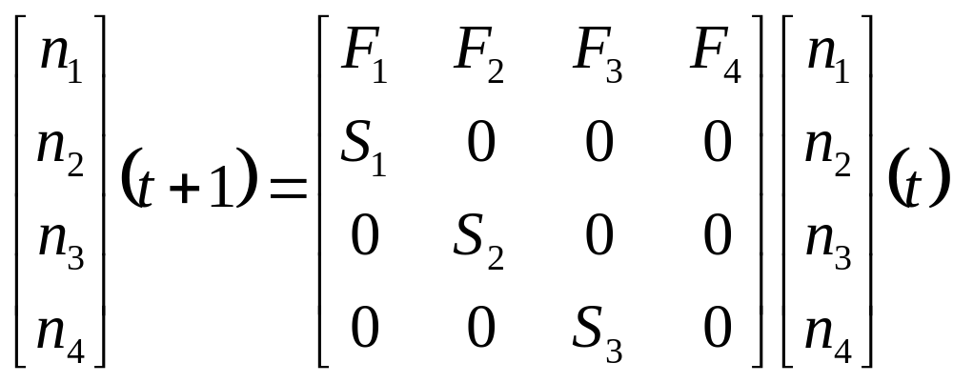
Age-structured Matrix Model

Slide 7
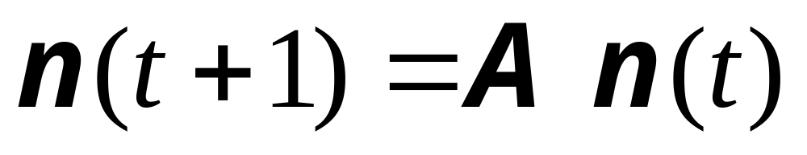
In matrix notation this is easier:

Slide 8
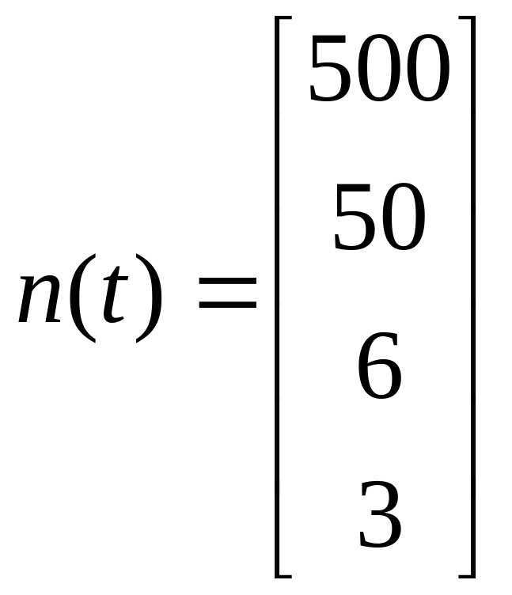
Real information for a population
n₁ = no. of eggs=500
n₂ = no. of yearlings=50
n₃= no. of 2-yr. olds=6
n₄ = no. of 3-yr. olds=3

Slide 9
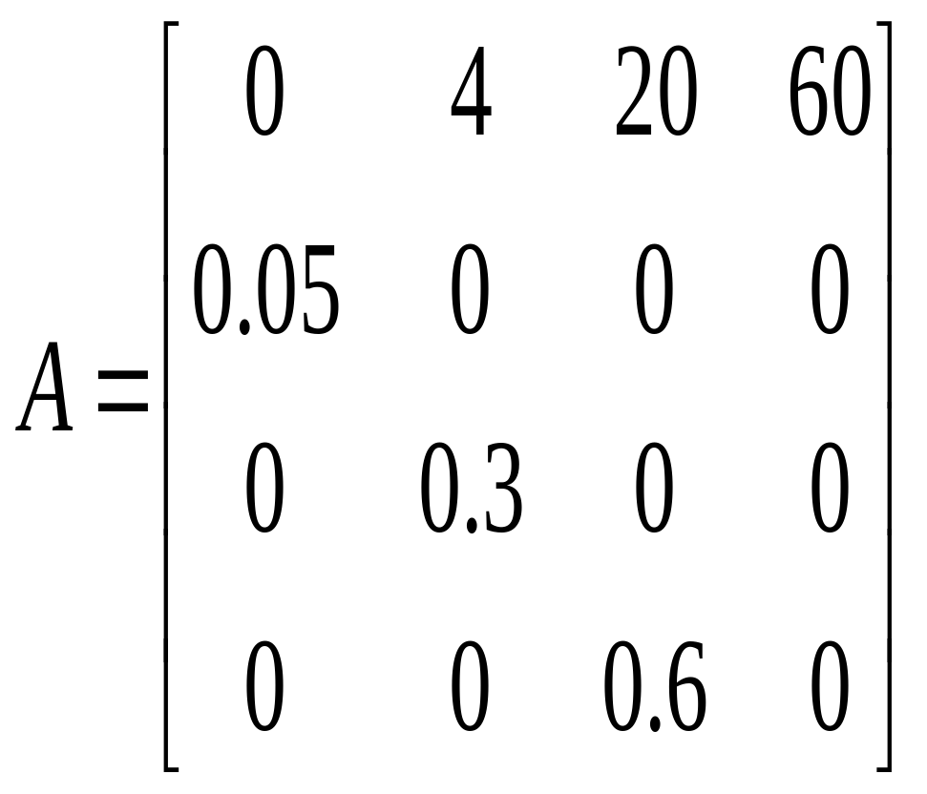
Real survival and fecundity rates for a population
F₂ = no. eggs per yearling = 4
F₃ = no. eggs per 2-yr old = 20
F₄ = no. eggs per 3-yr old = 60
S₁ = survival rate of eggs=0.05
S₂ = yearling survival = 0.3
S₃ = 2-yr old survival = 0.6

Slide 10
Age-structured Matrix Model also called Leslie Matrix after Leslie (1945, 1948)

Slide 11
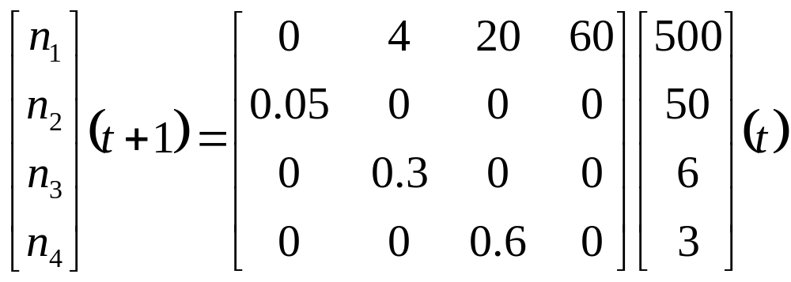
Age-structured Matrix Model

Slide 12
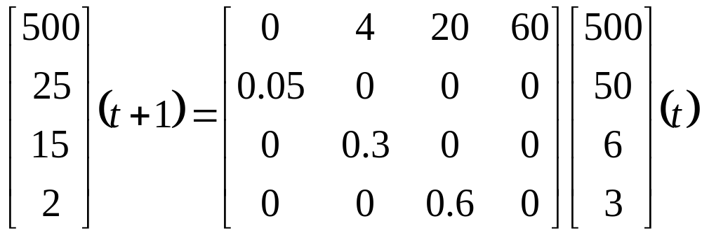
Age-structured Matrix Model

Slide 13
Age-structured Matrix Model

Slide 14
Summary of our population’s growth
At t=0 N = 500+50+6+3 = 559
At t=1 N = 542
At t=2 N = 558
At t=3 N = 596
At t=4 N = 422
At t=5 N = 421
At t=6 N = 384

Slide 15
We summarize (or simplify) a population’s growth rate as
λ = finite rate of increase
λ = 1.0 means population remains constant
λ = 1.2 means population increases 20% per year
For our example population λ = 0.93
This means that the population will decrease 7% per year over the long run

Slide 16
Remember the matrix notation :

Slide 17
Can we calculate λ from our (Leslie) population projection matrix?
λ is defined as solution to characteristic equation:
det(A – λI) = 0
λ is also called the dominant eigenvalue of the Leslie projection matrix
We can calculate λ fairly easily using a software program such as Matlab or Gauss once we’ve estimated values for A

Slide 18
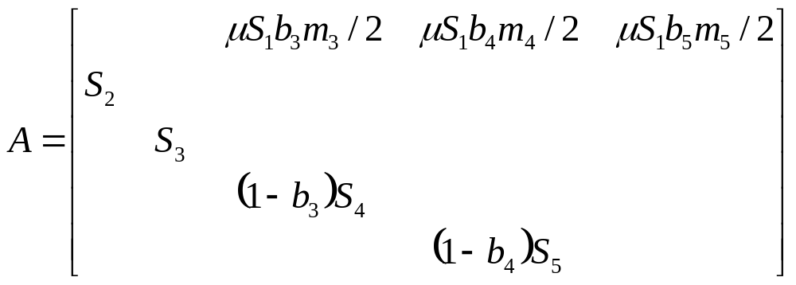
Snake River spring/summer chinook projection matrix

Slide 19
Where do values in matrix come from?
Kareiva, et al. used data summarized in the PATH process to estimate values for 1990-1994 brood years for 7 index stocks of Snake River spring/summer chinook:
Poverty Flat Marsh Creek
Johnson Creek Imnaha River
Bear Valley & Elk Creeks
Minam River Sulphur Creek

Slide 20
Survival Estimates
S_{x} is probability of survival to age x from age x-1
S₂ = [zS_{z} + (1-z)S_{d}]S_{e}
Survival during 2nd yr of life =
[(proportion of fish transported)(survival during transport) + (proportion of fish migrating in-river)(in-river survival)](survival in estuary & into ocean)

Slide 21
Survival Estimates
μ = (1-h_{ms})S_{ms}(1-h_{sb})S_{sb}
Survival during upstream migration =
(proportion not harvested in main stem)(Survival rate in mainstem)(proportion not harvested in subbasin)(survival rate in subbasin)

Slide 22
Fecundity estimates:
F₃ = μ S₁b₃m₃/2
Fecundity of 3rd age class (jacks) =
(Survival in upstream migration)(1st yr survival)(probability of breeding as a 3-yr old)(no. of eggs per 3-yr old female)/2

Slide 23
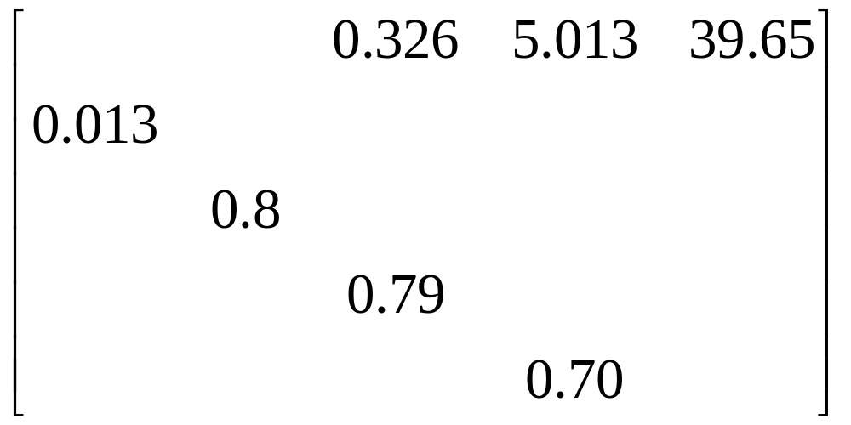
Projection matrix for Poverty Flat index stock

Slide 24
Long-term population projection for Poverty Flat index stock
λ = 0.76
This implies a 24% decline per year in population size for this stock if these rates are correct and if they remain the same in the future.

Slide 25
Does this rate of change make sense when compared to the historical Poverty Flat population?

Slide 26
What about other index stocks?

Slide 27
What if we eliminated all migration mortality?
Perfect survival during in-river migration is probably impossible to achieve but we can use these Leslie matrices to project its effect on each population rate of change.
See Fig. 2

Slide 28
Have past management actions been a waste of time and money?
Fig. 3 shows that past management actions targeting in-river survival have had a very positive effect .
Without these past efforts Kareiva et al. estimate that the rates of decline likely would have been 50 to 60% annually.

Slide 29
Could improved survival at other stages reverse the population declines?
“Management actions that reduce mortality during the first year by 6% or reduce ocean/estuarine mortality by 5% would be sufficient.”
Reducing mortality in both of these stages at once would require only a 3% and 1% reduction, respectively.

Slide 30
How to increase first year and estuarine survival?
“… dam breaching is unlikely to affect available spawning habitat or first-year survival
but could improve estuarine survival considerably.”

Slide 31
Benefits of barging?
“Although survival of juvenile fish during barging is quite high, barging might reduce the subsequent survival of barged fish relative to those that swim downstream.”
Is there delayed mortality associated with barging?

Slide 32
Benefits of breaching the Snake River dams?
“Breaching the lower Snake dams would mean the end of fish transportation operation and would therefore eliminate any delayed mortality from transportation.
Additionally… might increase the physiological vigor of salmon that swim downriver, thus improving survival during the critical estuarine phase.”

Slide 33
Indirect mortality
“If this indirect mortality were 9% or higher, then dam breaching could reverse the declining trend of the SRSS chinook salmon.
Unfortunately, estimating the magnitude of any indirect mortality from passage through the Snake River dams is difficult.”

Slide 34
Adaptive management
“Given the uncertainty, policy-makers may have to view the decision they make as large experiments, the outcomes of which cannot be predicted but from which we can learn a great deal pertaining to endangered salmonids worldwide.”

